Slide 1
A
Dashboard
On Data produced by
Sprocket Central Pty Ltd
Ankitkumar Dandiwala
Intern
KPMG

Slide 2
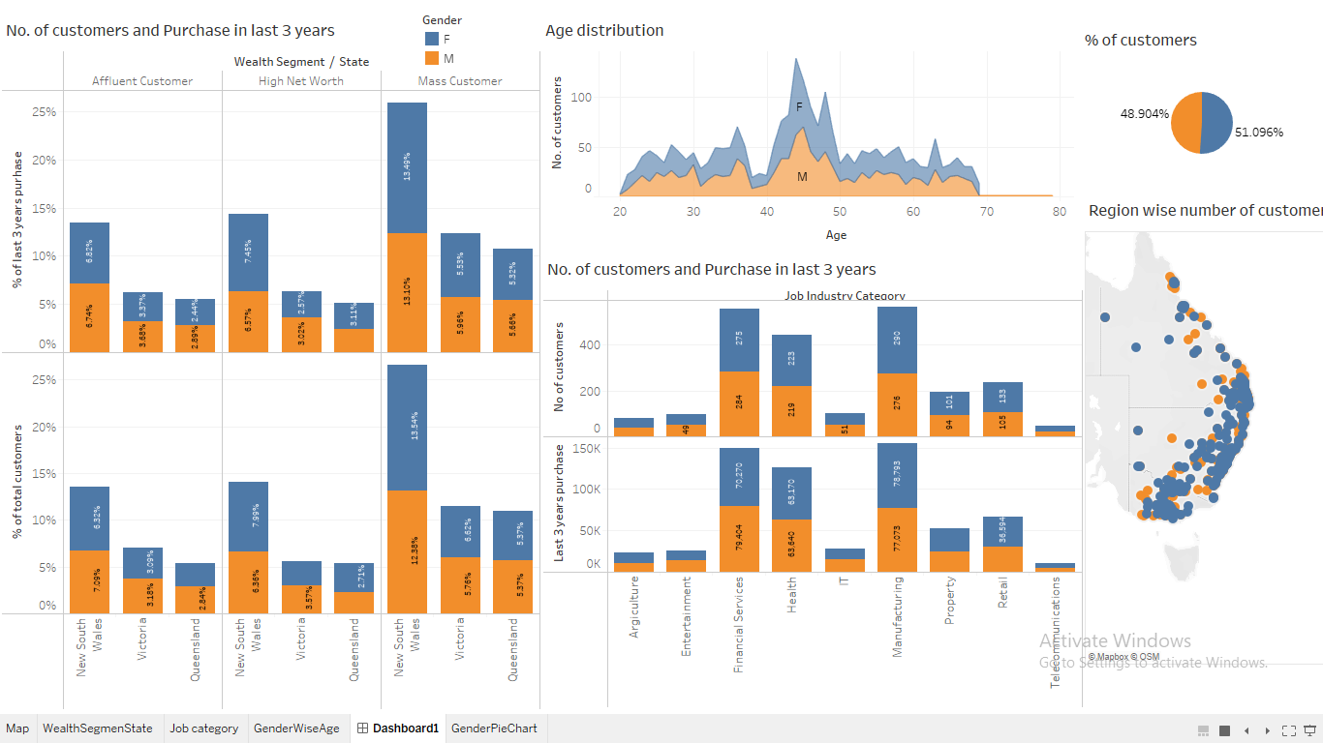

Slide 3
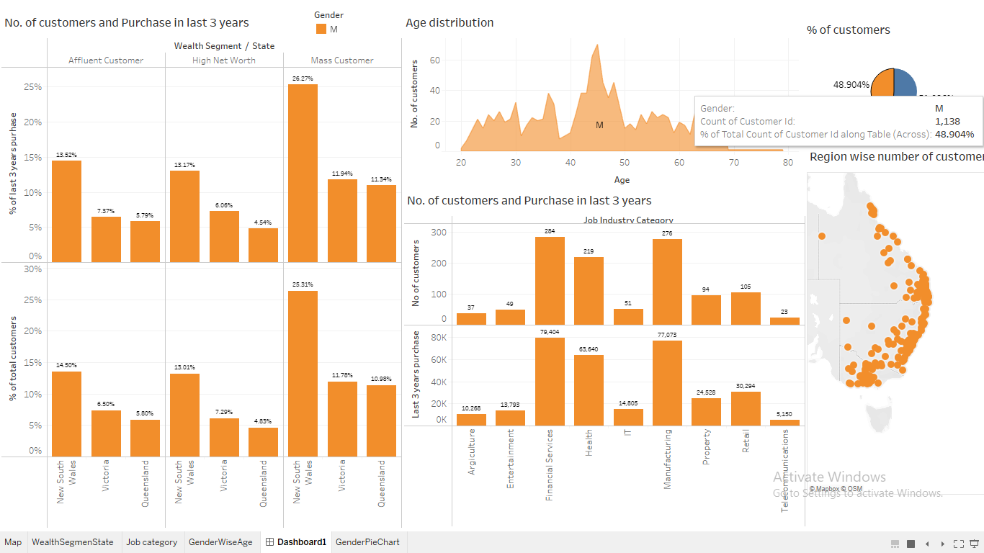

Slide 4
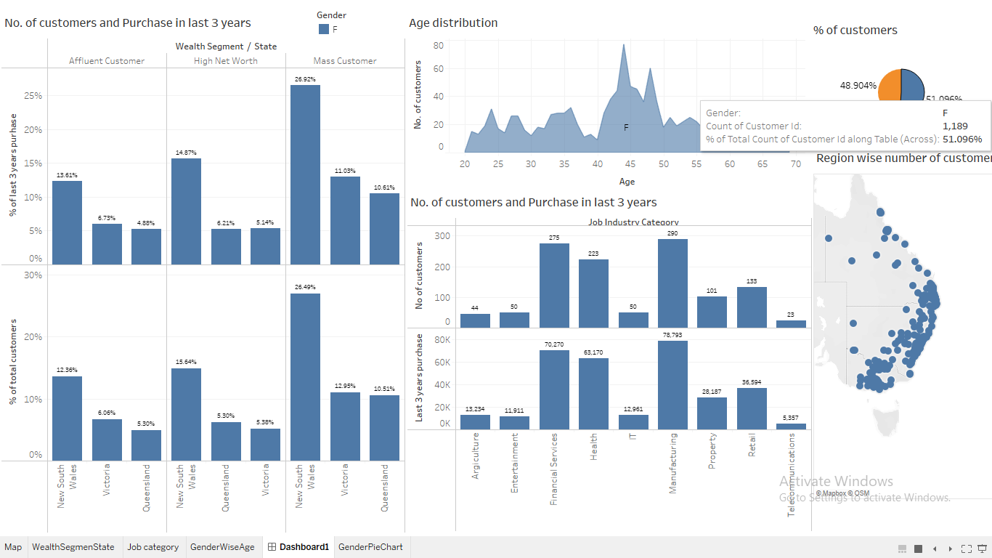

Slide 5
